Slide 1

StockVision : Stock Price Prediction
Darshan korde 23207003
Snehal Pawar 23207002
Atharva Nimkar 22107025
Monish Mudliar 22107027
Project Guide
Ms. Ujwala Pagare

Slide 2
Outline
Introduction
Literature Survey of the existing systems
Limitations of the existing systems
Problem statement
System Design
Technologies and methodologies
Implementation
Conclusion
References

Slide 3
Introduction
Stock price prediction is a significant challenge in machine learning and data science, focused on forecasting stock prices based on historical data and various market indicators. Accurate predictions are crucial for investors, traders, and financial analysts to make informed decisions and optimize investment strategies.
With advancements in machine learning and data analytics, we can leverage historical stock data to uncover trends and make informed forecasts. This project aims to bridge the gap between financial expertise and data-driven decision-making by developing a predictive model that assists investors in minimizing risks and maximizing returns. Ultimately, it seeks to enhance market understanding and improve investment strategies.

Slide 4
Motivation:-
Stock Market Volatility – Stock markets are highly volatile, making accurate price prediction crucial for investors and traders.
Limitations of Traditional Methods – Conventional analysis often fails to capture complex financial patterns, leading to inconsistent predictions.
Advancements in Machine Learning – Machine learning and data analytics enable us to analyze historical stock data to identify trends and patterns. Risk Minimization & Profit Maximization – A predictive model can help investors reduce risks and optimize returns.
Enhancing Market Understanding – The project contributes to better investment strategies by improving market insights.

Slide 5
Objectives:-
Market Trend Insights: In addition to price prediction, the system analyzes historical stock data to provide insights into market trends
Comparative Analysis Using Different ML Algorithms: The system compares LSTM with traditional models like ARIMA, RNN.
Investment Recommendations: It helps users decide whether to buy, hold, or sell stocks based on data-driven insights, maximizing returns and minimizing risks.
Interactive Interface (ChatBot): The chatbot provides natural language responses, making stock analysis easy and accessible for all users.

Slide 6
Literature Survey of the existing system
SR. NO | TITLE | AUTHOR | YEAR | OUTCOMES | METHODOLOGY | RESULT
1. | Stock Market Analysis and Prediction Using LSTM: A Case Study on Technology Stocks[1] | Zhenglin Li, Yuhong Mo | 2023 | This research explores the application of LSTM networks for analyzing and predicting stock prices of major technology companies, utilizing historical data from Yahoo Finance. | Machine learning algorithms were applied to a housing dataset, with cross-validation and accuracy metrics used for evaluation. | Random Forest and Neural Networks achieved higher prediction accuracy than linear regression models, suggesting that non-linear relationships and complex interactions between variables were better captured.

Slide 7
Literature Survey of the existing system
SR. NO | TITLE | AUTHOR | YEAR | OUTCOMES | METHODOLOGY | RESULT
2. | Forecasting Stock Prices Changes Using Long-Short Term Memory[2] | Gao et al. | 2023 | Demonstrated enhanced prediction accuracy by combining LSTM with Symbolic Genetic Programming (SGP). | Historical stock price data and Bollinger Bands were combined as inputs to LSTM models, with performance validated using RMSE and R-squared metrics. | The approach demonstrated effectiveness in predicting trends and reducing forecasting errors.

Slide 8
Literature Survey of the existing system
SR. NO | TITLE | AUTHOR | YEAR | OUTCOMES | METHODOLOGY | RESULT
3. | Stock Prediction Based on Optimized LSTM and GRU Models[3] | Gao et al | 2021 | Optimized LSTM models incorporating technical indicators and investor sentiment data achieved superior accuracy. | LSTM and GRU models were compared by incorporating technical indicators, with model optimization performed through hyperparameter tuning. | LSTM models consistently outperformed GRU models in terms of accuracy and trend detection.

Slide 9
Limitations of existing systems
Stock Prices Are Highly Volatile and Unpredictable:
Stock prices are influenced by multiple factors, including
market sentiment, economic policies, and unexpected
events, making them difficult to predict accurately using
traditional models.
Limitation: Lack of Clear Visual Representations
The current system does not provide clear visual outputs for
users to interpret stock trends, predicted price movements,
or model performance.
Lack of Real-Time User Interaction: The existing system
does not provide a way for users to interact and ask stock
related queries dynamically.

Slide 10
Problem statement
Stock Prices Are Highly Volatile and Unpredictable: Enhance prediction accuracy by integrating real-time financial news, sentiment analysis, and macroeconomic indicators into the LSTM model.
Lack of Clear Visual Representations: Providing comparative analysis between ml modles like LSTM, RNN, ARIMA and their comparative graphs with accuracies.
Lack of Real-Time User Interaction: Integrate a chatbot that allows users to query stock predictions, historical trends, and insights in real time.

Slide 11
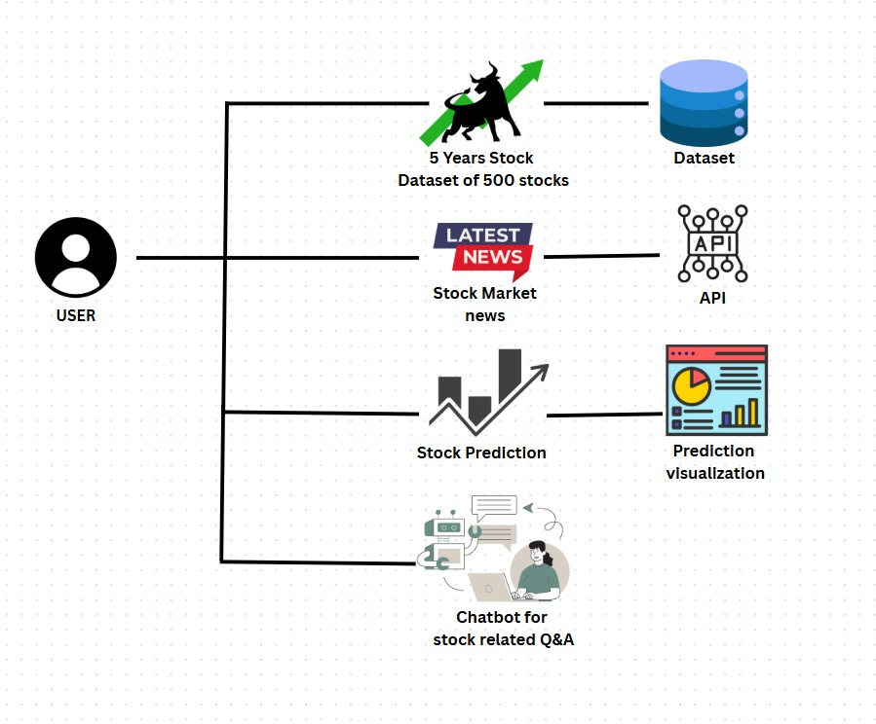
System Design

Slide 12
Technologies and methodologies
Front-End:
HTML5
CSS3
Back-End:
Python (3.11.0)
Dataset:
Dataset from Kaggle
619041(Rows)
7(Columns)
Algorithm:
LSTM
RNN
ARIMA

Slide 13
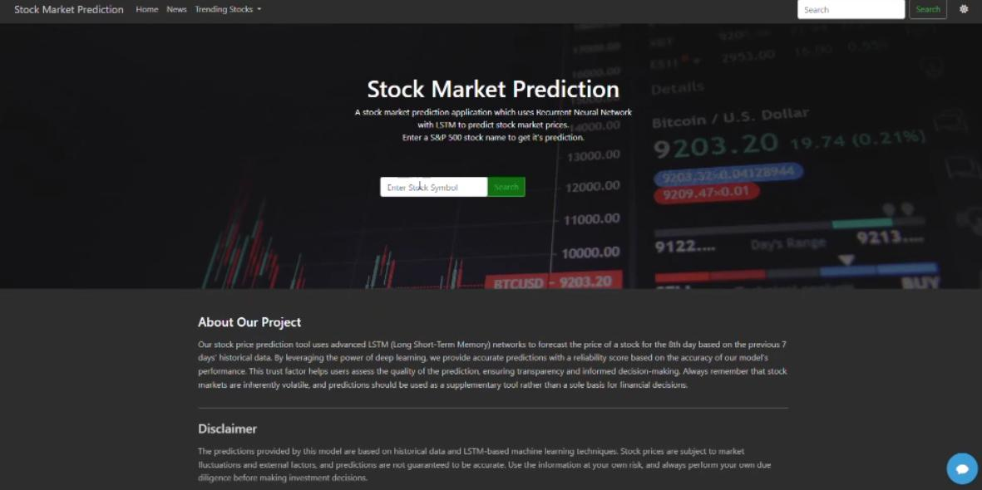
Implementation
Fig.1: Home Page

Slide 14
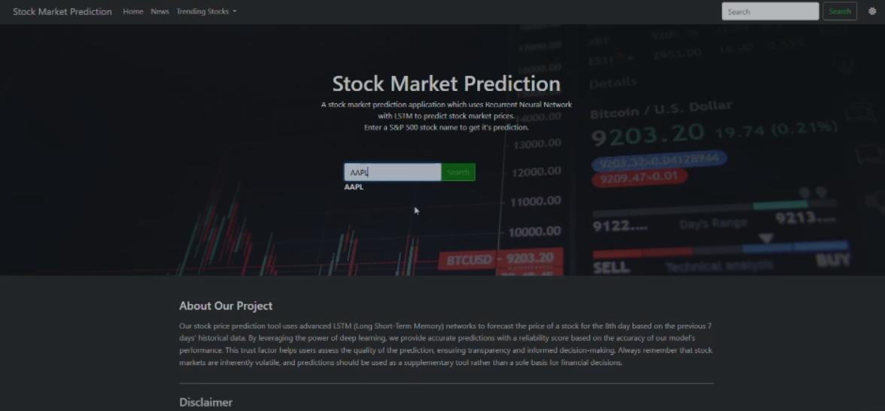
Implementation
Fig.2: Search page

Slide 15
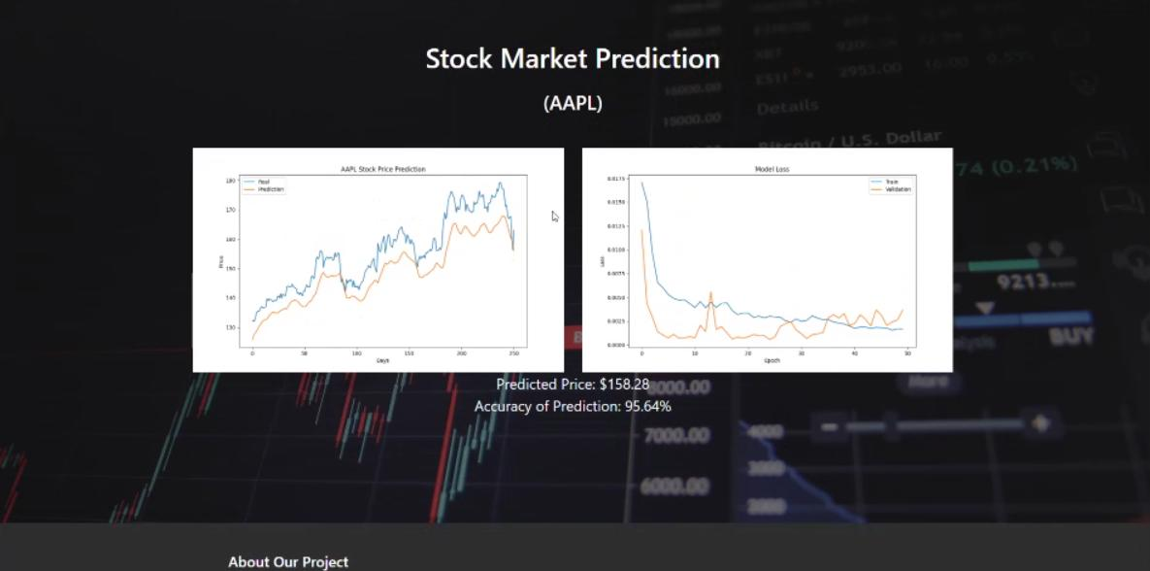
Implementation
Fig.3: Predicted Prices

Slide 16
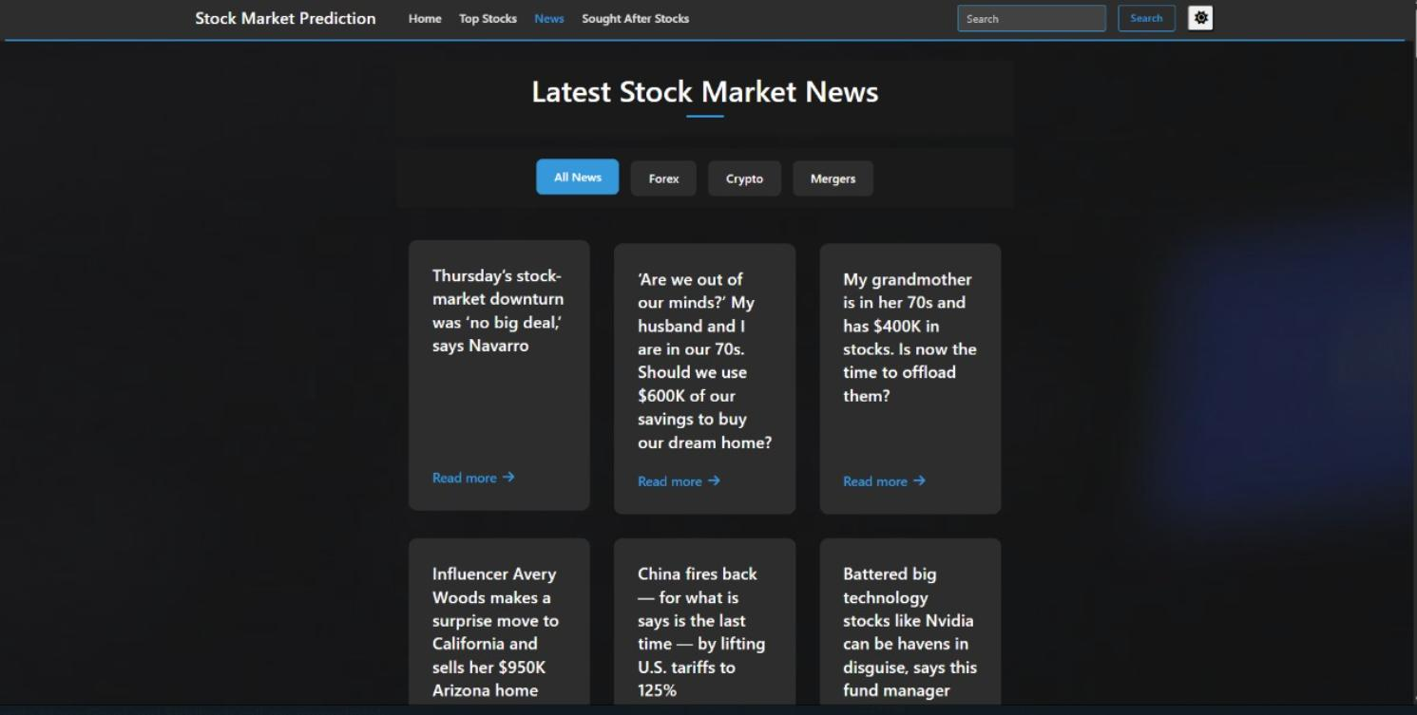
Implementation
Fig 4.: Latest Stock Market News

Slide 17
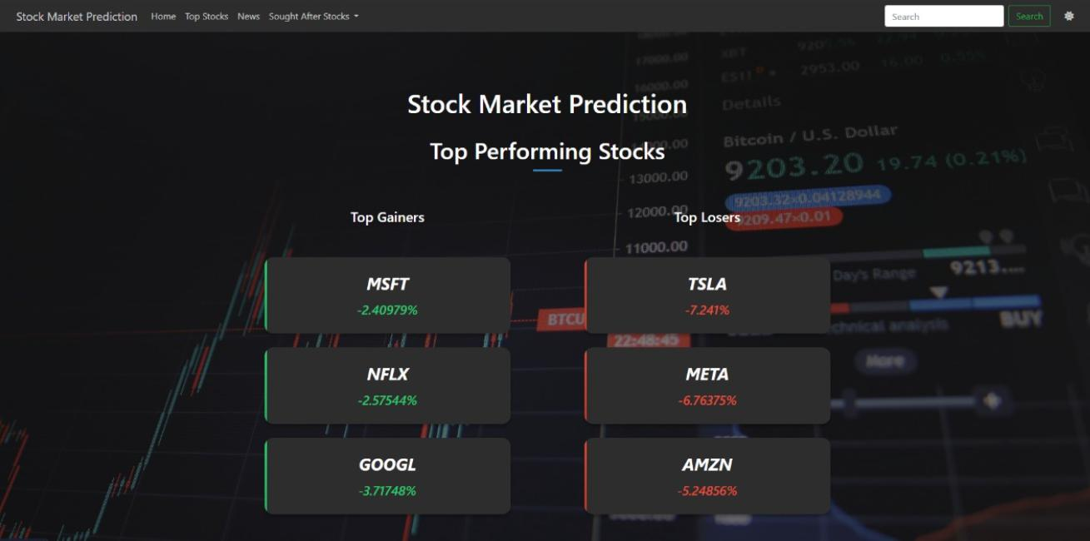
Implementation
Fig.5: Top Performing Stocks

Slide 18
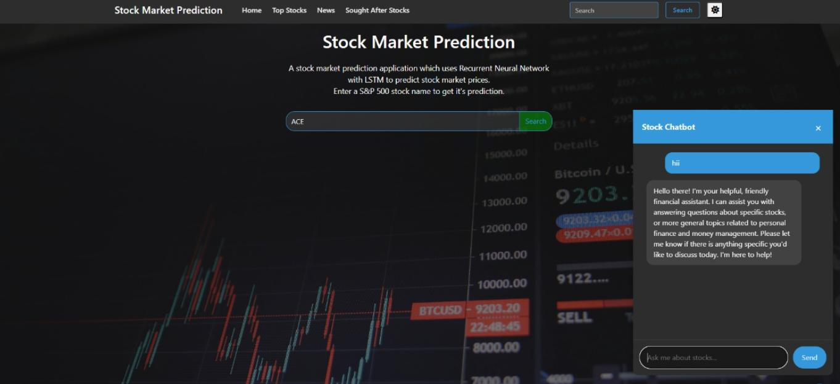
Implementation
Fig.6: Interactive Chatbot

Slide 19
Conclusion
In conclusion, our stock price prediction project has demonstrated the potential of advanced modeling techniques to improve the accuracy and reliability of forecasting stock market trends. By leveraging modern deep learning algorithms, such as Stacked LSTM, the project highlights the ability to capture complex patterns in historical data. Overall, it provides a solid foundation for more accurate and insightful stock price predictions, benefiting investors, financial analysts, and market professionals alike.

Slide 20
References
[1] Patel, S. K., & Jadhav, A. (2022). “Stock Price Prediction Using Regression and Machine Learning Techniques." 2022 IEEE International Conference on Smart Technology and Management (ICSTM). https://doi.org/10.1109/ICSTM53887.2022.9768004
[2] Stock Price Prediction And Forecasting Using Stacked LSTM
Deep Learning
https://youtu.be/H6du_pfuznE?si=rbw87uY311D68Y_8
[3] Kumar, R., & Singh, D. (2023). LSTM Deep Learning-Based Stock Price Prediction with Bollinger Bands. Published in Springer Journal of Financial Analytics and Decision Making.
[4] Chen, M. (2023). Forecasting Stock Prices Changes Using Long-Short Term Memory. Published in IEEE Transactions on Computational Finance and Economics.

Slide 21
Thank You...!!

